Slide 1
Veri Bilimi : Python ile Uygulamalı Doğal Dil İşleme
Sentence Bert
Monitoring NLP models in production
Interpretability of Models
Bias & Ethics in NLP
3 Ocak 2024

Slide 2
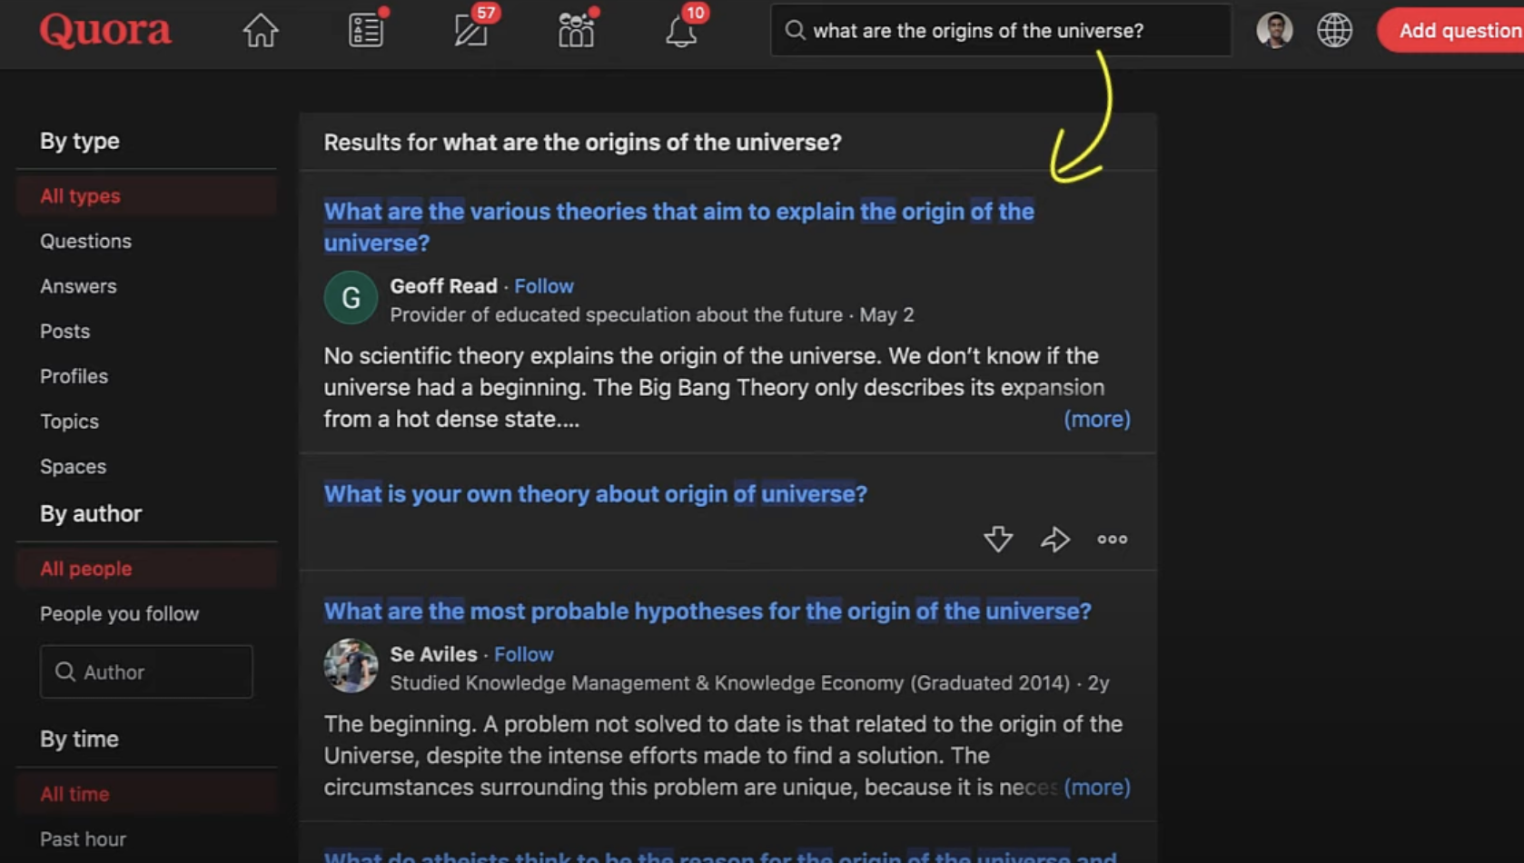
Sentence BERT - SBERT
Slide credit:

Slide 3
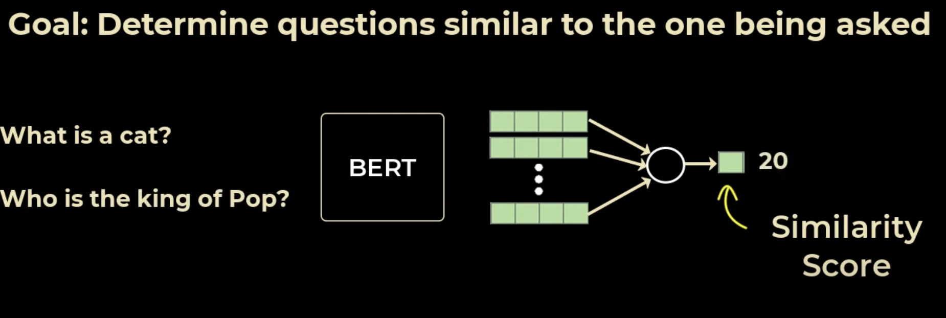

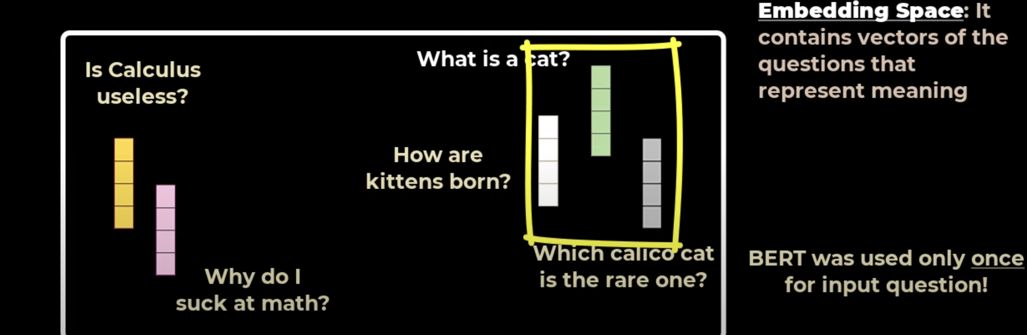
Sentence BERT - SBERT
Slide credit:

Slide 4
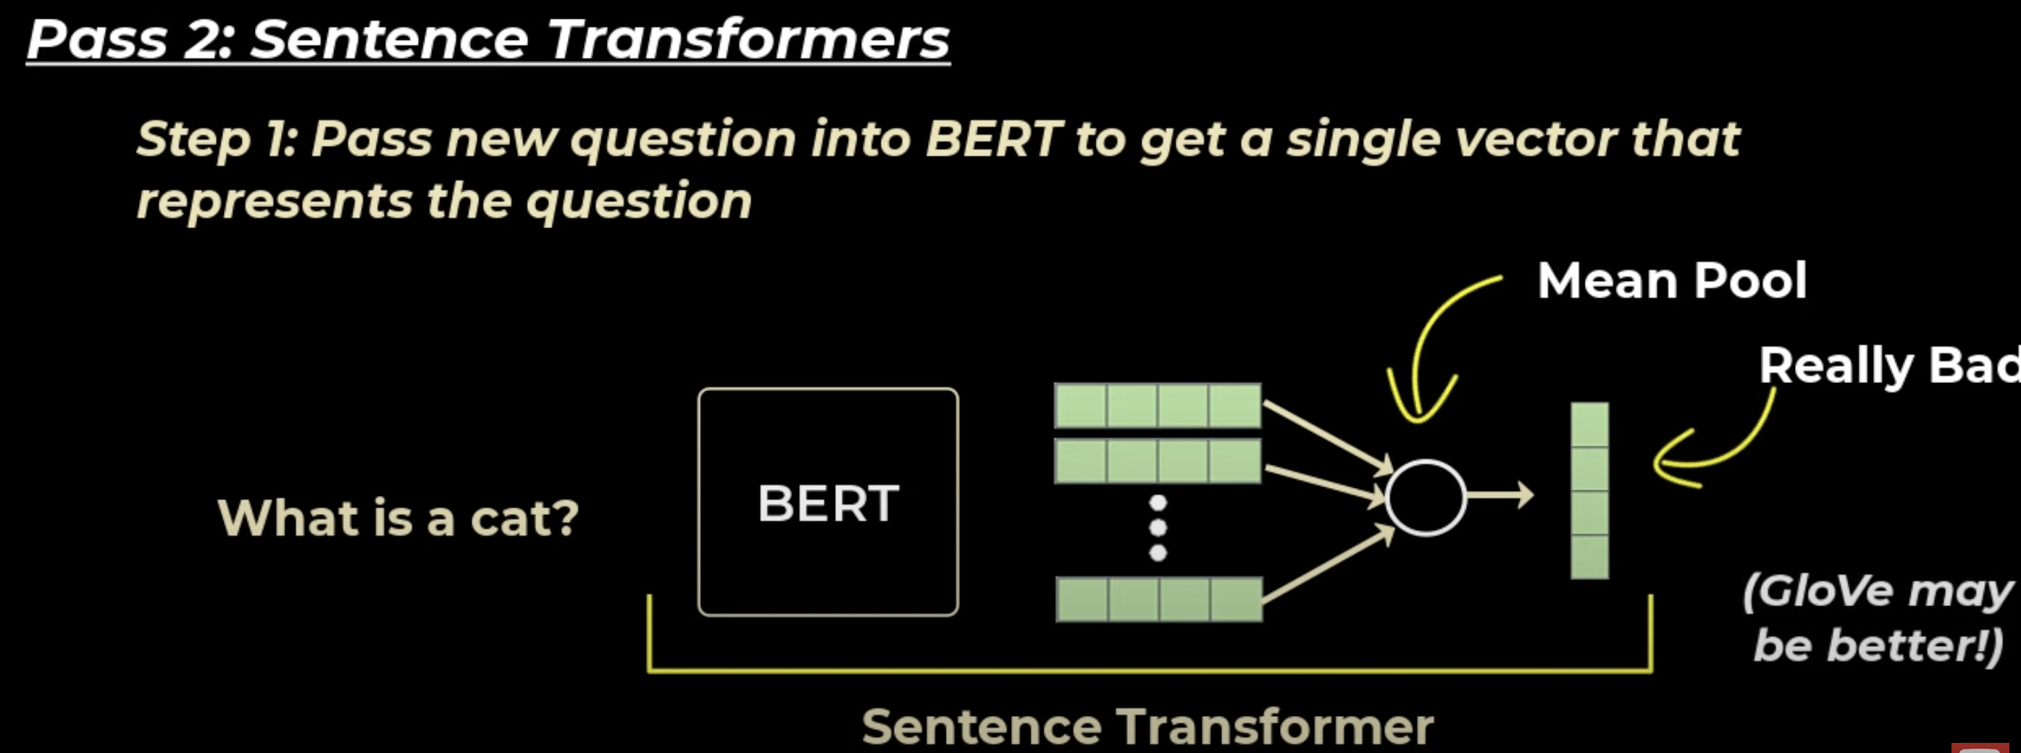
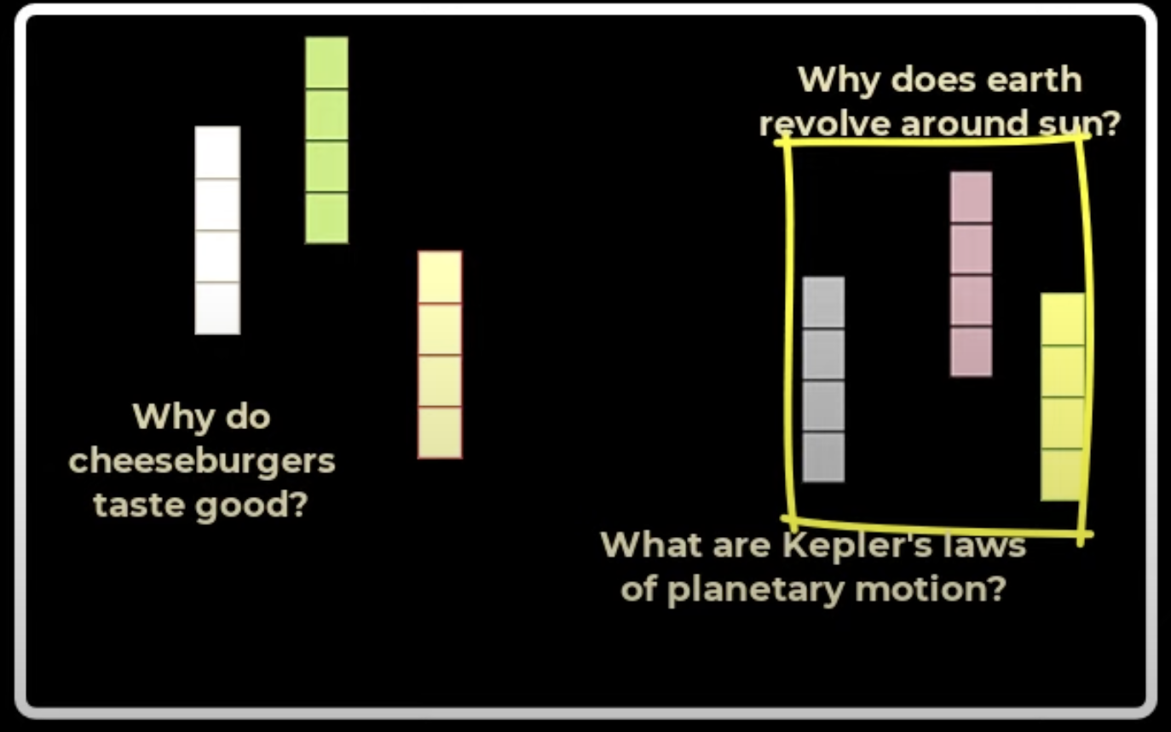
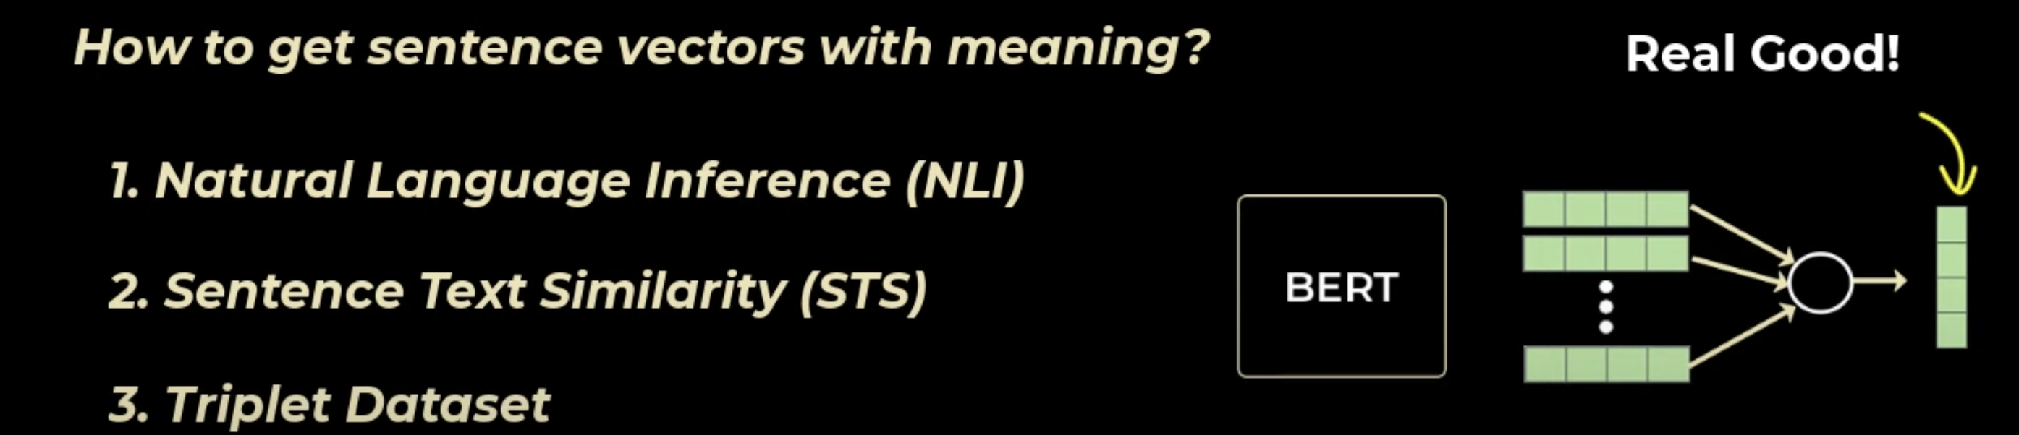
Sentence BERT - SBERT
ANNOY - approximate nearest neighbors
KNN – Elastic Search
Slide credit:

Slide 5
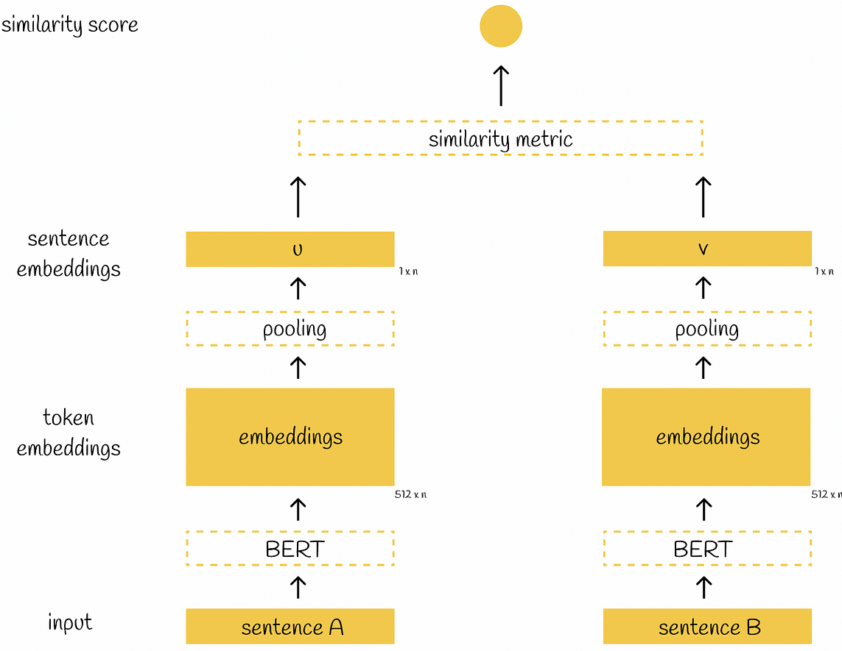
Sentence BERT - SBERT
Better Sentence Representations
Efficiency in Similarity Computations
Training for Similarity Tasks
Handling Longer Texts
Practical Applications
Slide credit:
Notes:
Here's why sentence transformers are often preferred over using raw BERT embeddings:
1. Better Sentence Representations: BERT was primarily trained for token-level tasks (like masked language modeling) rather than for generating holistic sentence embeddings. As a result, directly using BERT's embeddings (like those from its last layer or the CLS token) for sentence-level tasks might not capture the full semantic meaning of the entire sentence. Sentence transformers, on the other hand, are fine-tuned specifically to produce embeddings that are more representative of the entire sentence's meaning.
2. Efficiency in Similarity Computations: With BERT, comparing two sentences typically requires passing both sentences concatenated together through the model, which can be computationally expensive, especially for large datasets. Sentence transformers generate embeddings that are directly comparable using simpler similarity metrics (like cosine similarity), making the process much more efficient.
3. Training for Similarity Tasks: Sentence transformers are often fine-tuned on specific tasks like semantic textual similarity, paraphrase identification, or information retrieval. This fine-tuning process makes them more adept at capturing nuances in sentence meanings that are crucial for accurately measuring sentence similarities.
4. Handling Longer Texts: BERT has a token limit (typically 512 tokens), which can be a limitation when dealing with longer texts. Sentence transformers often incorporate strategies to handle longer texts more effectively.
5. Practical Applications: For many real-world applications like search engines, recommendation systems, or chatbots, the ability to quickly and accurately compare sentence meanings is crucial. Sentence transformers are designed with these applications in mind, offering a balance between accuracy and computational efficiency.
In summary, while BERT can be used for encoding sentences, sentence transformers offer enhancements in terms of efficiency, accuracy, and applicability for tasks involving sentence-level semantic understanding and comparisons.

Slide 6
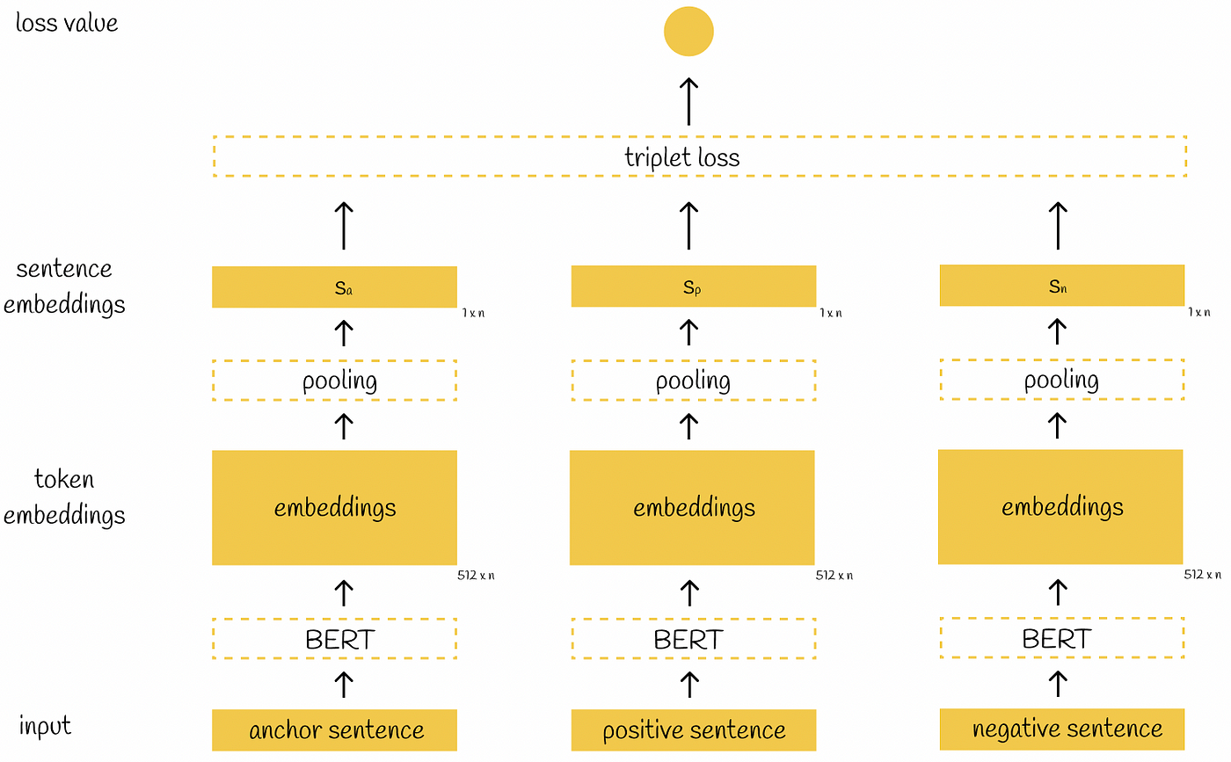
Sentence BERT - SBERT
Pair Loss (e.g., Contrastive Loss)
Advantages:
- Simplicity:
- Flexibility: It
- Data Requirements:
Challenges:
Less Discriminative: The model might not learn to differentiate as effectively between subtly different classes or examples.
Triplet Loss
Advantages:
Fine Discrimination:
Relative Comparisons:
Challenges:
Complexity:
Data Preparation: It requires careful selection of triplets, which can be challenging and time-consuming.
Hard Negative Mining: Often requires a strategy to select 'hard' negatives (dissimilar examples that are not too easy to distinguish).
Which One to Choose?
- Task Specificity: If your task requires fine discrimination between very similar items (like in recommendation systems), triplet loss might be more beneficial. For more general tasks, pair loss could suffice.
- Data Availability and Quality
Slide credit:
Notes:
- Use Case: Triplet loss involves three items: an anchor, a positive example (similar to the anchor), and a negative example (dissimilar to the anchor). The goal is to make the anchor and positive closer in the embedding space while pushing the anchor and negative farther apart.
Choose:
- Data Availability and Quality: If you have high-quality data and the resources to construct meaningful triplets, triplet loss could be advantageous. For simpler setups or when such resources are limited, pair loss is more practical.
- Computational Resources and Complexity: Triplet loss can be more computationally intensive and complex to implement. If computational efficiency and ease of implementation are priorities, pair loss might be the better choice.
In summary, the choice depends on your specific needs, the nature of your data, and your computational resources. Both approaches can be effective in different contexts.

Slide 7
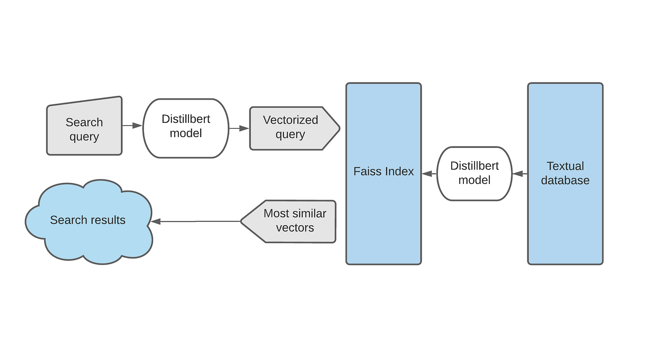
Sentence BERT - SBERT
Slide credit:
Notes:
"Semantik arama, geleneksel anahtar kelime eşleştirmesinin aksine cümlelerin anlamına odaklanan bir bilgi alma sistemidir. Bu amaç için kullanılabilecek birçok metin gömme yöntemi olmasına rağmen, büyük bir veri koleksiyonundan düşük gecikme süreleriyle veri çekebilen API'lar oluşturmayı büyütmenin nadiren tartışıldığını görmekteyiz. Bu yazımda, en son teknolojiye sahip cümle gömmeleri (cümle dönüştürücüsü) ve FAISS kullanarak minimal bir semantik arama motoru nasıl geliştirebileceğimizi anlatacağım.”
FAISS
Faiss is a C++ based library built by Facebook AI with a complete wrapper in python, to index vectorized data and to perform efficient searches on them. Faiss offers different indexes based on the following factors
search time
search quality
memory used per index vector
training time
need for external data for unsupervised training
So choosing the right index will be a trade-off between these factors.

Slide 8
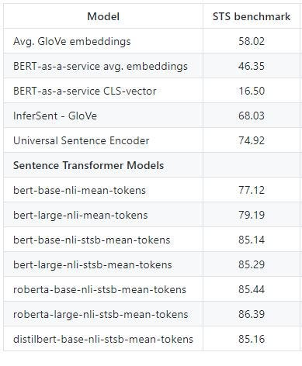
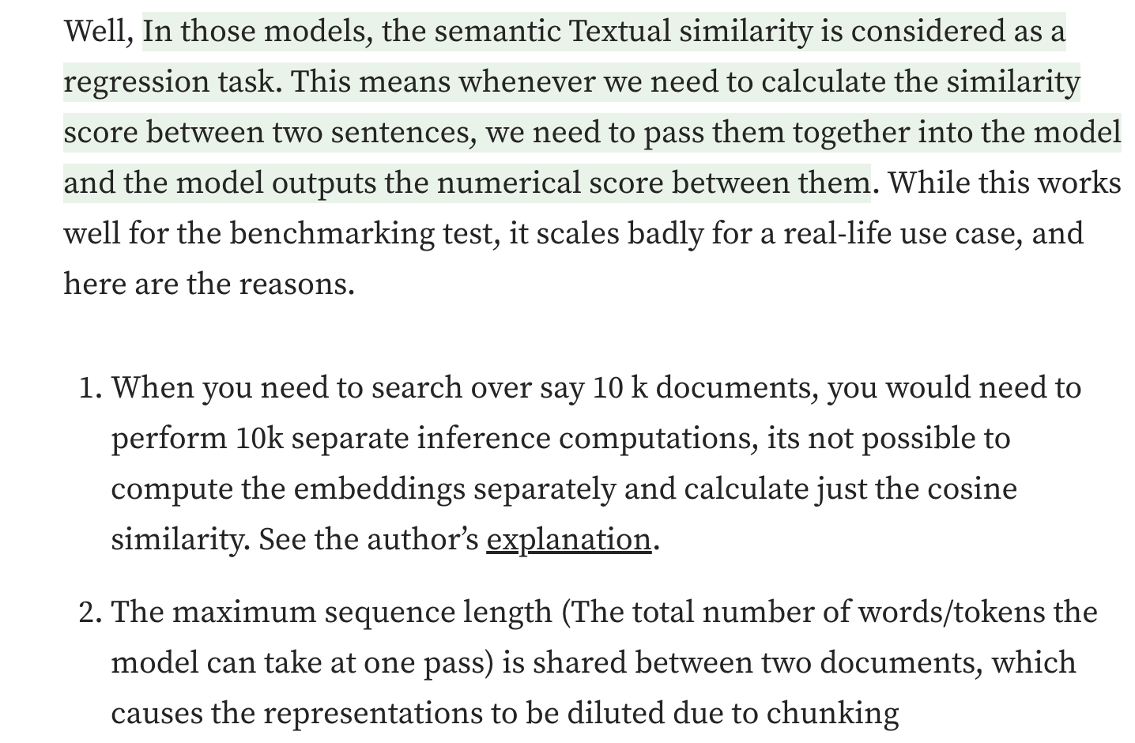
Sentence BERT - SBERT
Slide credit:
Notes:
Bu, cümle veya paragrafların yoğun vektör temsillerini veren bir model ya da modeller topluluğudur. Bu modeller, özellikle Semantik metinsel benzerlik görevi için özelleştirilmiş dönüştürücü ağlarıdır (BERT, RoBERTa, vb.). Çünkü BERT, bu tür görevler için kutudan çıktığı gibi iyi performans göstermez. Aşağıda, farklı modellerin STS referansında nasıl performans gösterdiği yer alıyor. Görüleceği üzere, Cümle dönüştürücü modeller, diğer modellere göre büyük bir farkla daha iyi performans gösteriyor.
Ama papers with code ve GLUE'un liderlik tablosuna bakarsanız, 90'ın üzerinde birçok model görebilirsiniz. Peki, neden Cümle dönüştürücülere ihtiyacımız var?
Bunun sebebi, bu modellerde semantik metinsel benzerlik, bir regresyon görevi olarak ele alınır. Bu, iki cümlenin benzerlik puanını hesaplamak istediğimizde, onları birlikte modele geçirmemiz ve modelin aralarındaki sayısal puanı vermesi anlamına gelir. Bu, referans testi için iyi çalışsa da, gerçek hayat senaryolarında kötü ölçeklenir ve işte nedenleri. Diyelim ki 10 bin doküman üzerinde arama yapmanız gerekiyor, o zaman 10 bin ayrı çıkarım hesaplaması yapmanız gerekir. Gömülenleri ayrı ayrı hesaplayıp sadece kosinüs benzerliğini hesaplamak mümkün değildir. Yazarın açıklamasına bakınız.
Maksimum dizin uzunluğu (Modelin tek seferde alabileceği kelime/token sayısı) iki doküman arasında paylaşılır, bu da temsillerin parçalara ayrılması nedeniyle seyrelmesine yol açar.

Slide 9
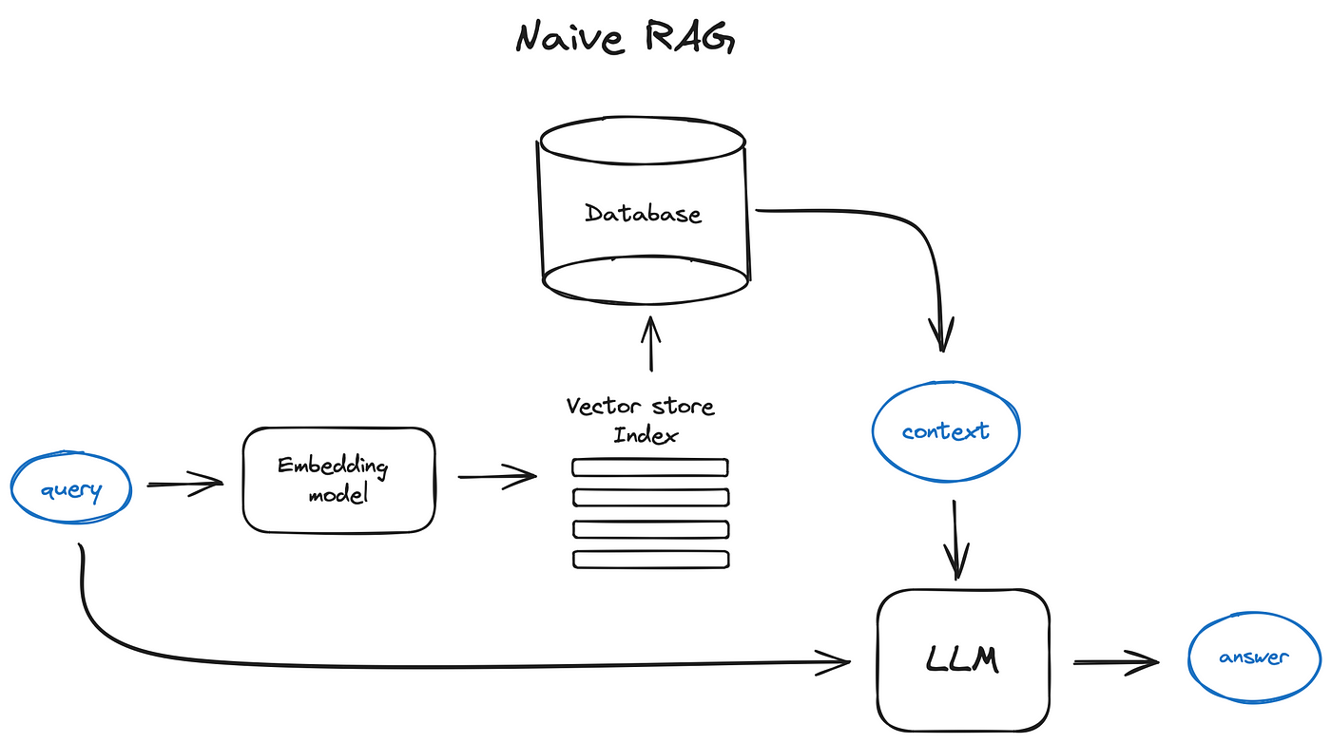
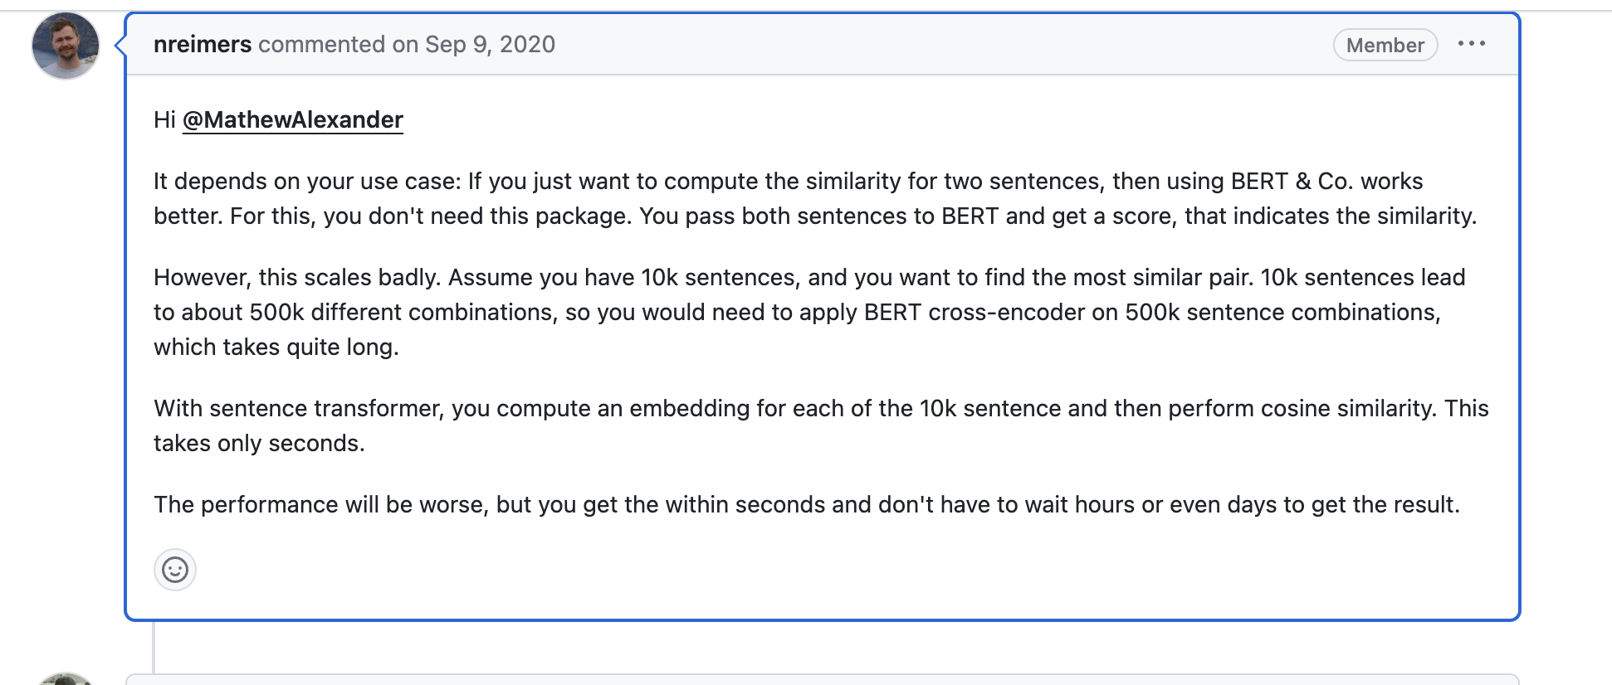
Search with LLM’s – a sneak peek
CODING TIME!!
Slide credit:

Slide 10
Search with LLM’s – a sneak peek
Slide credit:

Slide 11
SBERT
CODING TIME!!
Semantic Search in Publications
https://colab.research.google.com/drive/12hfBveGHRsxhPIUMmJYrll2lFU4fOX06?usp=sharing#scrollTo=4idfE76lJvXZ
Building-movie-recommendation
https://colab.research.google.com/drive/1d_cdEBb-GB0oYR2BGLqOq3SQ0mUgzUzA#scrollTo=octukYx1wHbI
Slide credit:

Slide 12
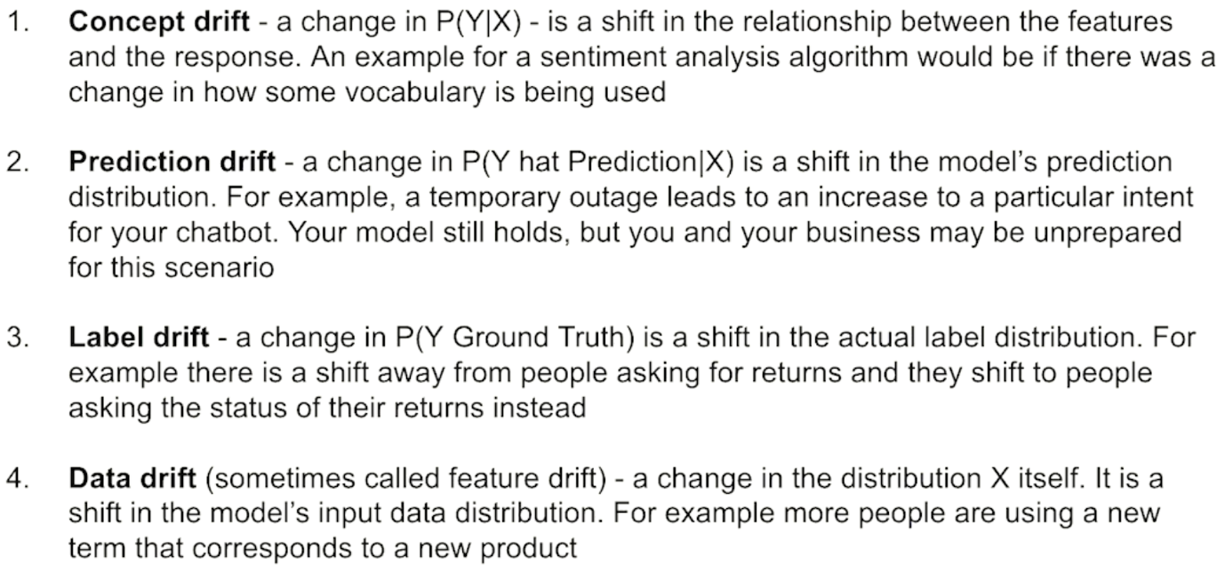
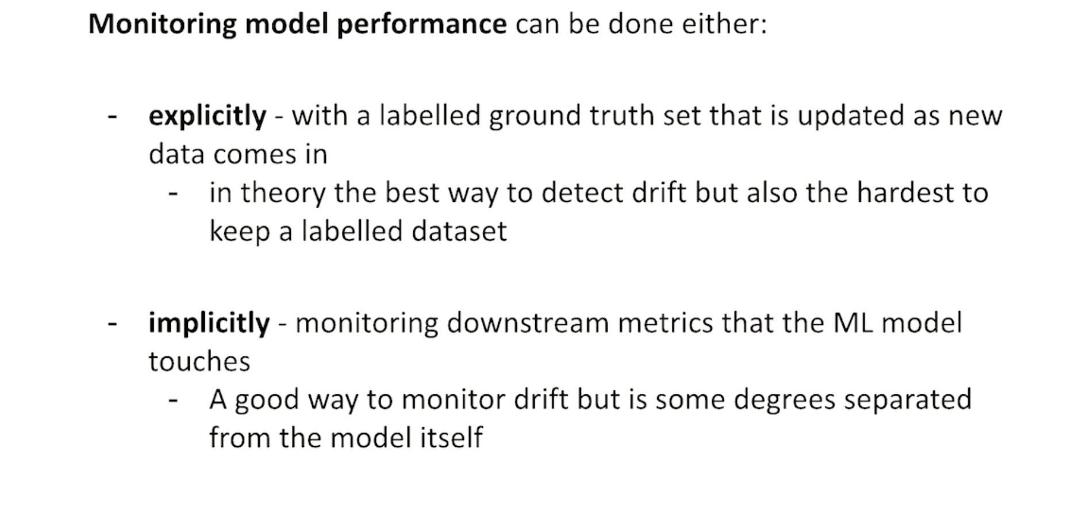
Detecting Drift
Slide credit:
Notes:
Exp -> birilerini arada test yapması. Modelle yemek yeme
Imp -> label disrtrituon ın değişimini monitor edebilirsin. Birşeylerin değiştini gösterir. Doalylı metriklerin takibi. Örneğin call cente aramalarını artması, başvuruların /uygun başvurların azalması

Slide 13
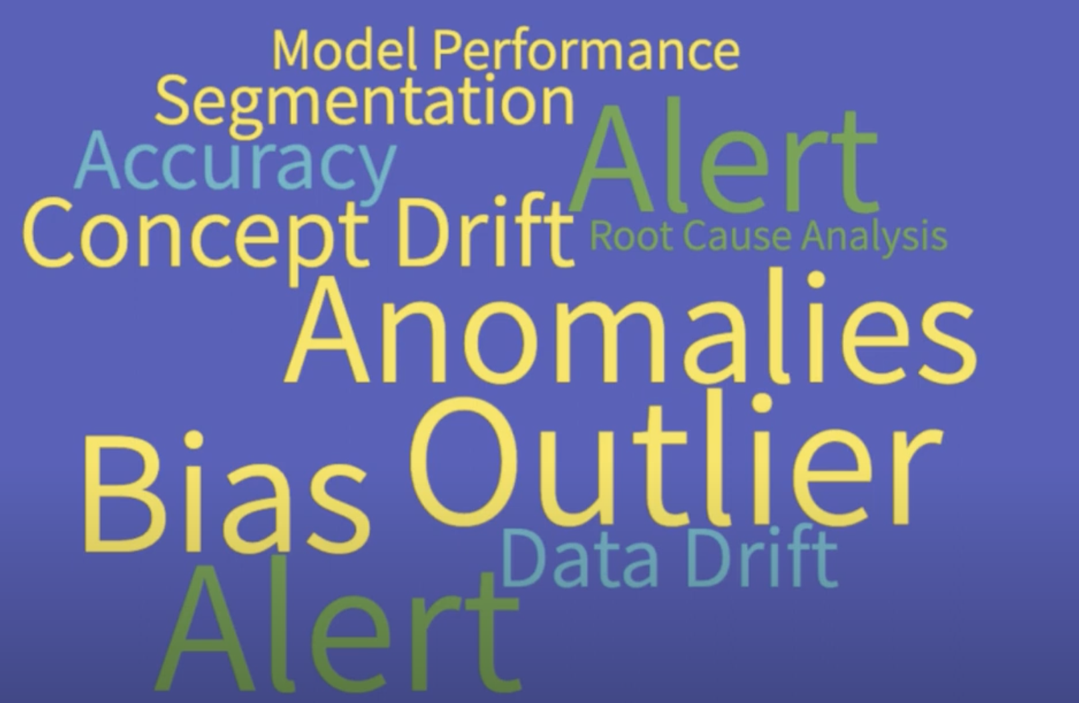
Monitoring NLP models in production
Slide credit:
Notes:
Why we need to monitor?

Slide 14
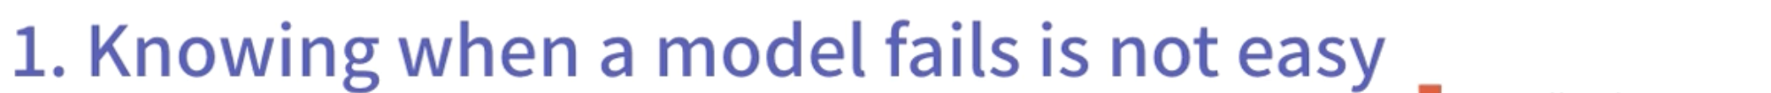
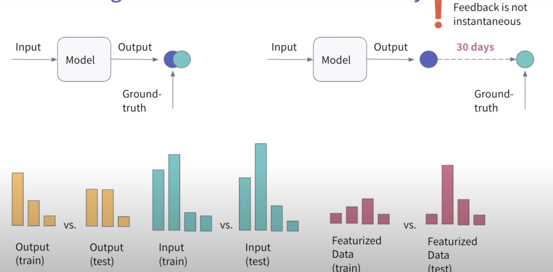
Monitoring NLP models in production
Why is it a hard problem?
Slide credit:
Notes:
Why we need to monitor?

Slide 15
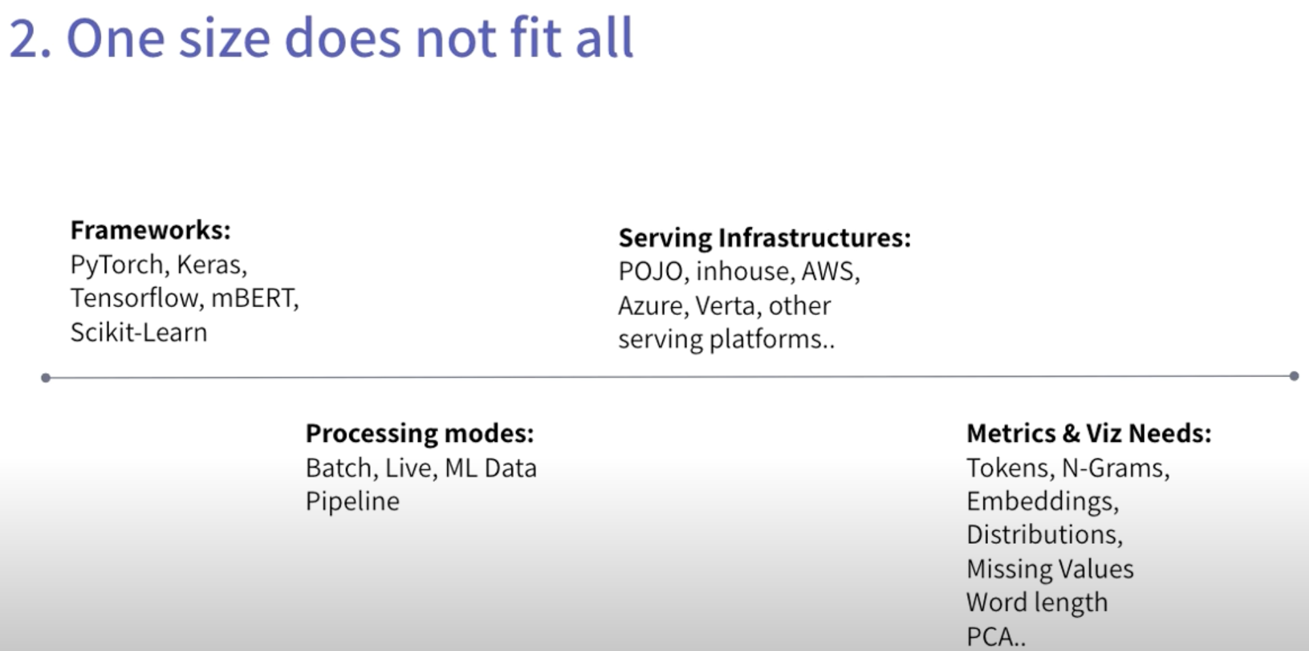
Monitoring NLP models in production
Why is it a hard problem?
Slide credit:
Notes:
Why we need to monitor?

Slide 16
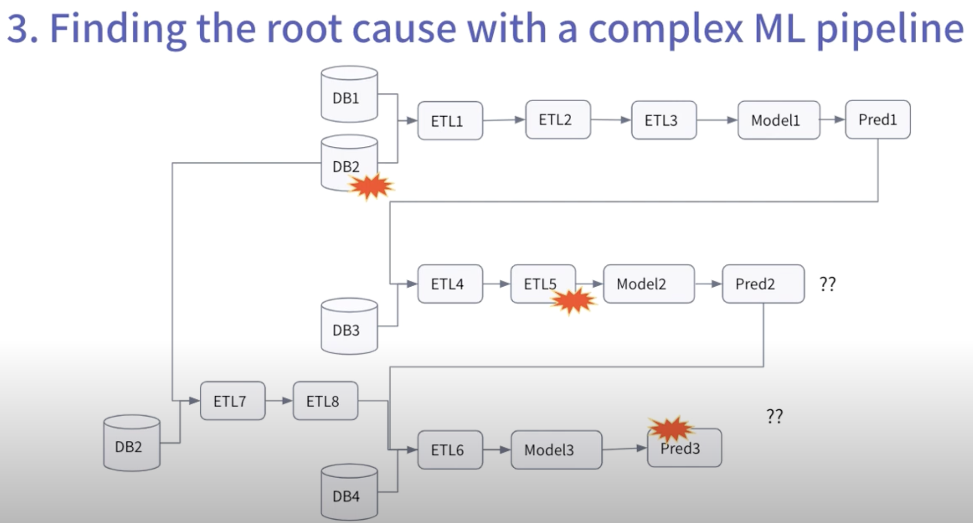
Monitoring NLP models in production
Why is it a hard problem?
Slide credit:
Notes:
Why we need to monitor?

Slide 17
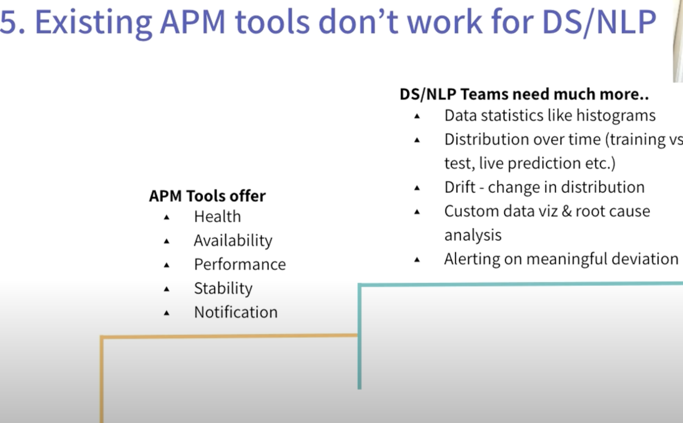
Monitoring NLP models in production
Why is it a hard problem?
NLP Models
Software
Slide credit:
Notes:
Why we need to monitor?

Slide 18
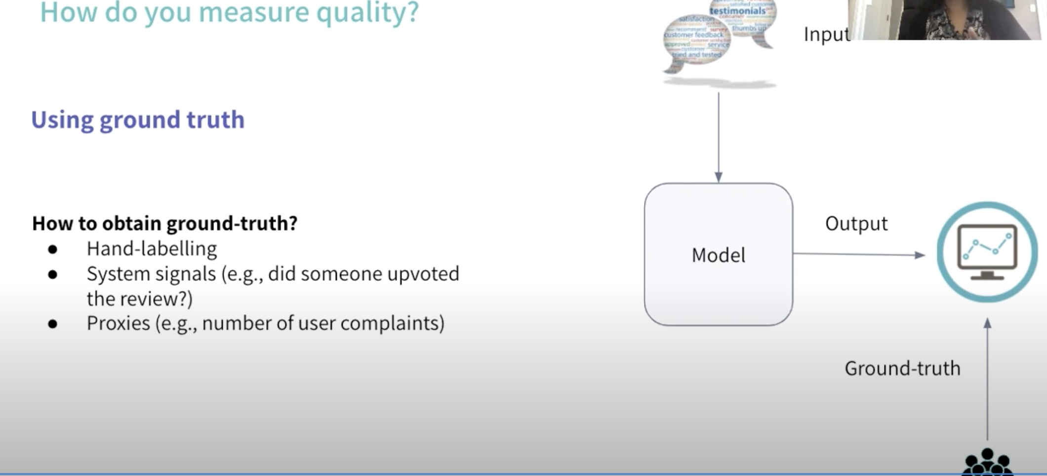
Monitoring NLP models in production
Know a model fails
Slide credit:
Notes:
Why we need to monitor?

Slide 19
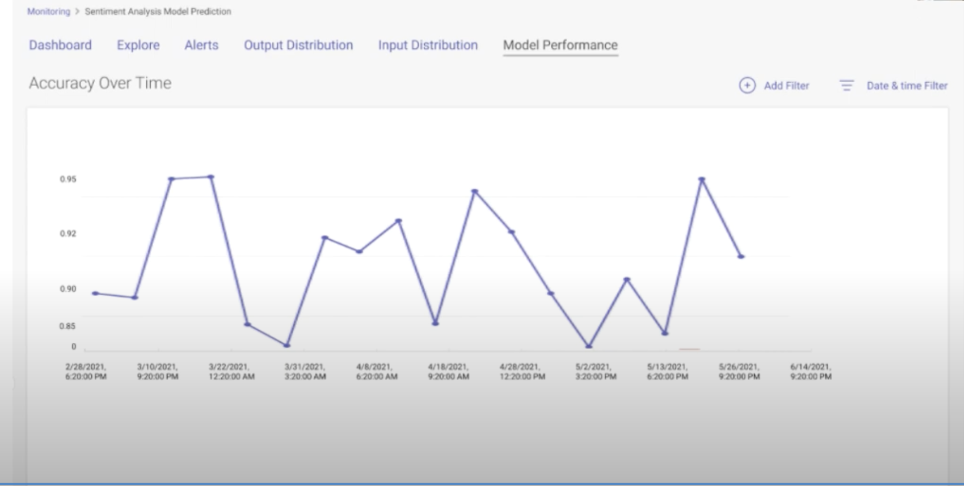
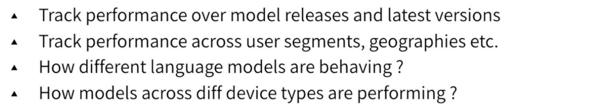
Monitoring NLP models in production
Track model performance over time
Slide credit:
Notes:
Why we need to monitor?

Slide 20
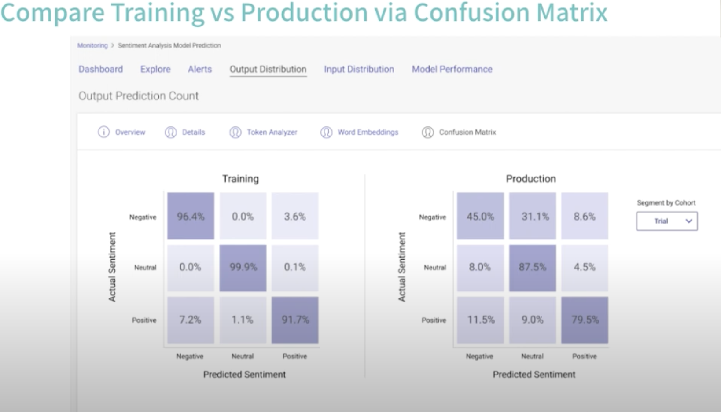
Monitoring NLP models in production
Compare Training & Production
Slide credit:
Notes:
Why we need to monitor?

Slide 21
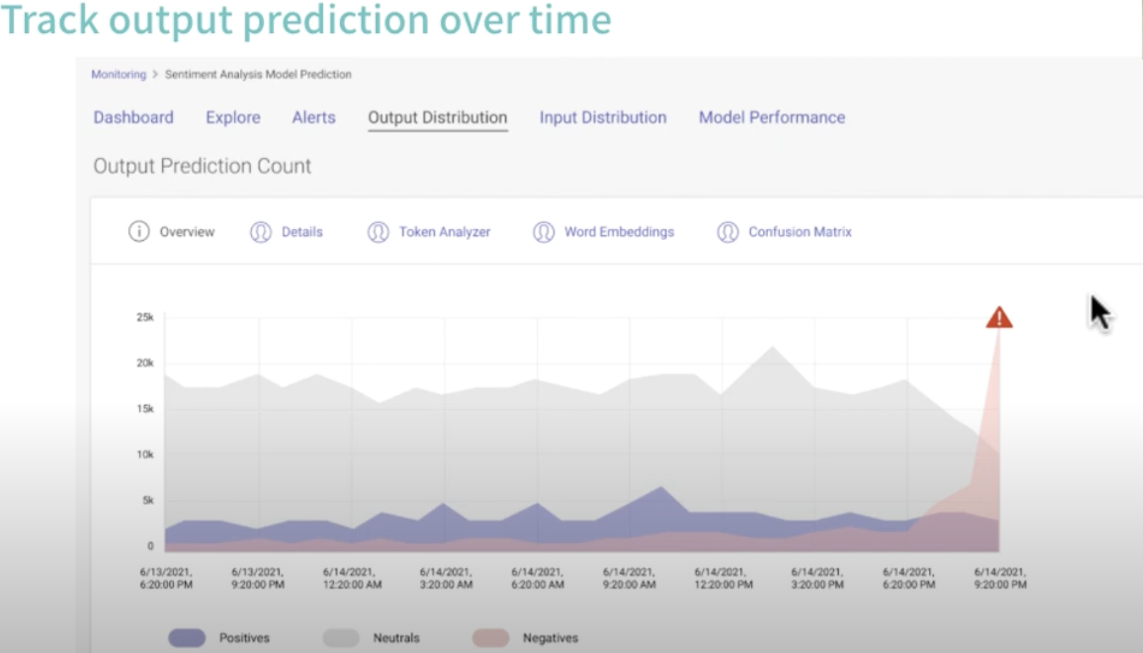
Monitoring NLP models in production
What if we can’t get feedback
Slide credit:
Notes:
Why we need to monitor?

Slide 22
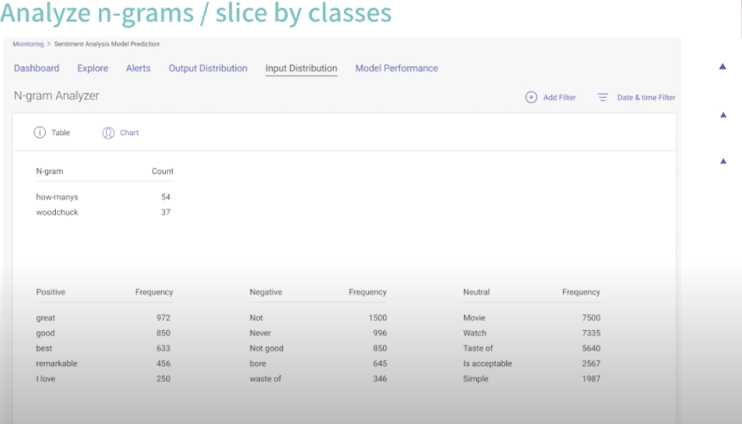
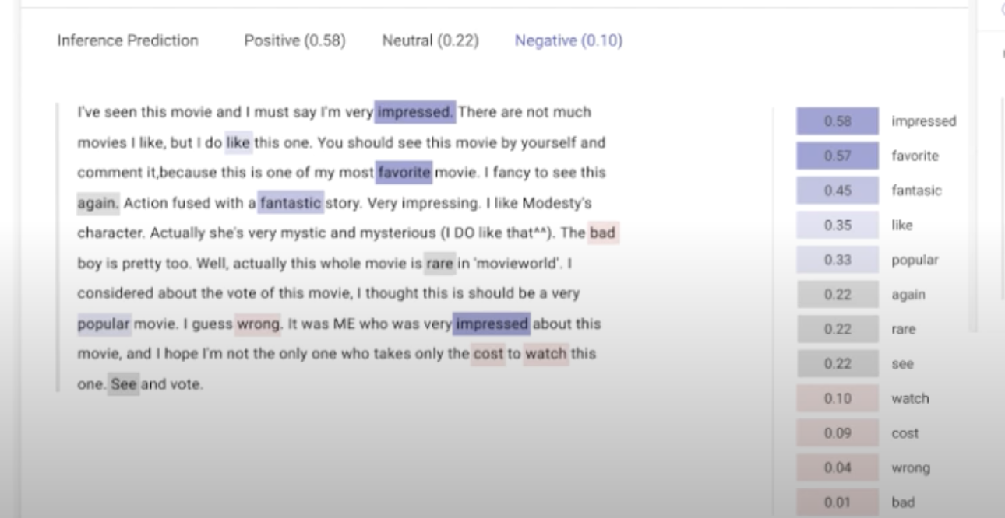
Monitoring NLP models in production
What if we can’t get feedback
Slide credit:

Slide 23
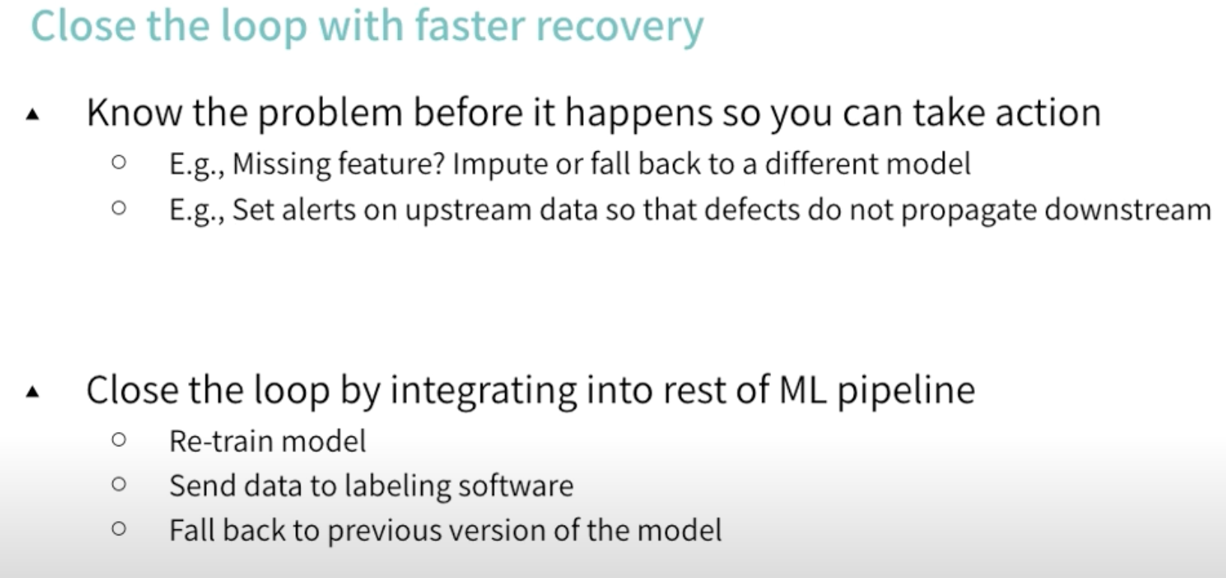
Monitoring NLP models in production
Remediate
Slide credit:

Slide 24
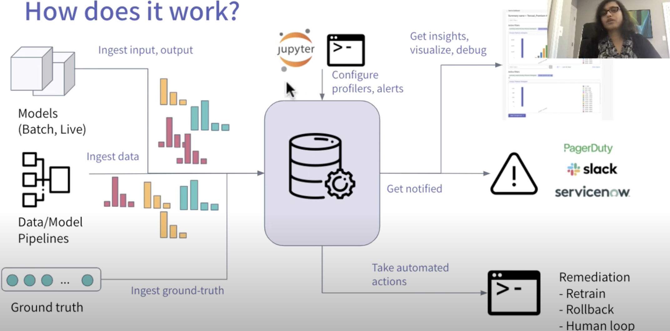
Monitoring NLP models in production
Slide credit:

Slide 25
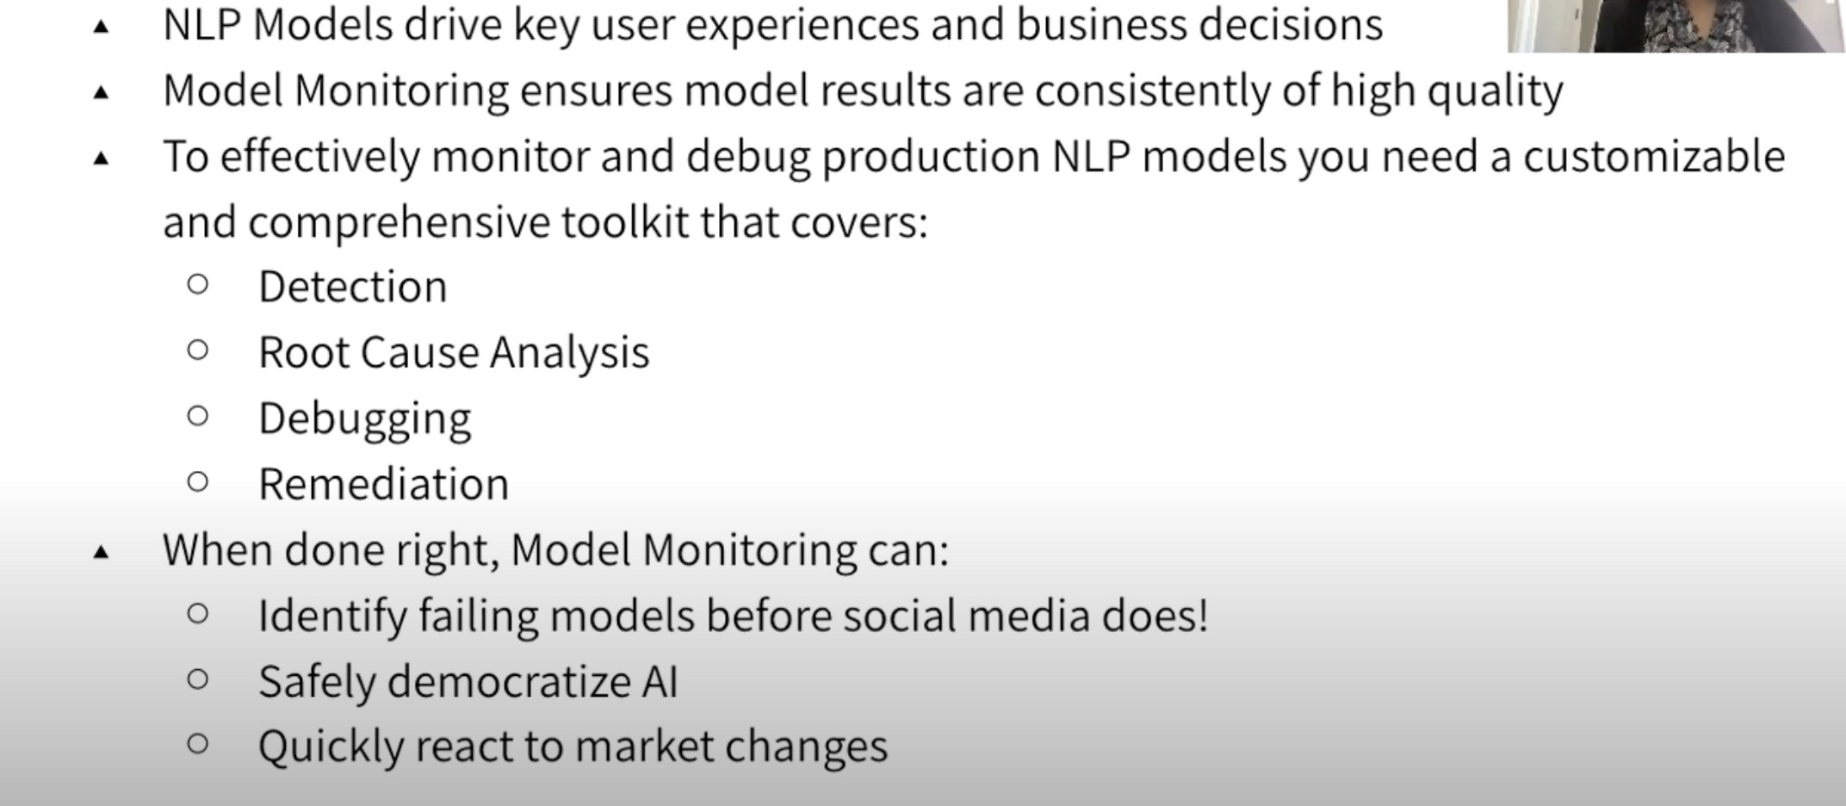
Monitoring NLP models in production
Summary
Slide credit: Meeta Dash, VP Product

Slide 26
Monitoring NLP models in production
https://colab.research.google.com/drive/15ON-Ub_1QUYkDbdLpyt-XyEx34MD28E1#scrollTo=OQYdNSdr__8j
http://192.168.19.65:5000/#/experiments/8
Slide credit:

Slide 27
Explanation vs Interpretation
Why should I trust you?
Model explanation and model interpretation are distinct concepts. The weights of a linear or logistic regression can be interpreted, whereas the weights of a complex neural network are not easily interpretable.
When we refer to explanation, we are talking about presenting textual or visual evidence that offers a qualitative understanding of how the components of an instance (such as words in text or patches in images) relate to the model's prediction.
For instance, if we are predicting the sentiment of a sentence like
"Amazing place to visit. Enjoyed the rides."
as positive,
the model should emphasize the words "Amazing" and "Enjoyed."
Slide credit:
Notes:
Interpretation->yorumlama

Slide 28
LIME
Data Sampling: LIME starts by creating perturbed versions of the input text by randomly adding or removing words. These perturbed samples are then fed into the NLP model.
Prediction Explanation: LIME uses the predictions made by the NLP model on the perturbed samples to learn a simpler, interpretable model, such as a linear or decision tree model. The interpretable model is trained to approximate the behavior of the NLP model in the local region around the instance of interest.
Feature Importance: LIME calculates the importance of each feature (i.e., word or token) based on the learned interpretable model. The importance is typically represented as a weight or score assigned to each feature, indicating its contribution to the prediction.
Explanation Visualization: The feature importance scores obtained from LIME can be visualized to provide a human-readable explanation. For example, the most important words or tokens can be highlighted or displayed along with their respective weights, indicating their impact on the model's prediction.
Slide credit:
Notes:
LIME, NLP modellerinin tahminlerini nasıl yaptığını açıklayan bir tekniktir. Girdi metnin hafifçe değiştirilmiş versiyonlarını oluşturur ve modelin tahminlerinin bu değişikliklere nasıl tepki verdiğini gözlemleyerek çalışır. Bu bilgilere dayanarak, belirli bir bölgede NLP modelinin davranışını yaklaşık olarak temsil eden daha basit bir model oluşturur. Bu basit model, modelin tahminleri için hangi kelimelerin veya özelliklerin önemli olduğunu belirlemeye yardımcı olarak, yorumlanabilir bir açıklama sağlar.

Slide 29
LIME
CODING TIME!!
Slide credit:

Slide 30
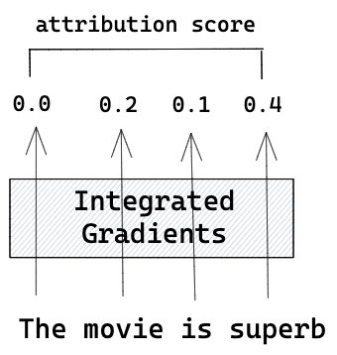
Integrated Gradients
Integrated Gradients allow examination of inputs' importance for the output in deep learning models.
Deep neural networks lack interpretability compared to linear regression models.
Linear regression allows accurate estimation of the impact of independent variables through weights.
Hidden layers in neural networks blur the input-output relationship due to the absence of direct links.
In large models with many neurons, it becomes impractical to trace the data path for interpretation.
Integrated Gradients provide a solution to understand model behavior and identify important features.
Slide credit:

Slide 31
Integrated Gradients
Start with a baseline: We choose a simple starting point, like a vector of zeros or the average of the input tokens' embeddings. (Baseline Token Representation)
Gradually change the tokens: We modify the input tokens step by step, moving from the baseline towards the original input representation. (Token Perturbation:)
Predict at each step: At each intermediate step, we feed the modified tokens into BERT and get predictions. These predictions could be probabilities for different classes. (Model Prediction)
Measure token importance: We calculate the importance of each token by looking at how much the predictions change as we modify the tokens. We consider how sensitive the model's output is to changes in the token representation. (Attribution Calculation)
Combine token importance: We add up or average the importance scores of each token to get an overall measure of importance for the input sequence. (Aggregation)
By following these steps, Integrated Gradients helps us understand which tokens are most important for BERT's predictions. It provides insights into why BERT makes certain predictions and helps us analyze and interpret its results.
Slide credit:
Notes:
Token'ları yavaşça değiştirin: Baseline'a doğru ilerleyerek girdi token'larını adım adım değiştiririz.
Her adımda tahmin yapın: Her ara adımda, değiştirilmiş token'ları BERT'e vererek tahminler alırız. Bu tahminler, farklı sınıflar için olasılıklar olabilir.
Token önemini ölçün: Token'ların önemini hesaplamak için, token'ları değiştirirken tahminlerin ne kadar değiştiğine bakarız. Modelin çıktısının token temsilindeki değişikliklere ne kadar hassas olduğunu düşünürüz.
Token önemini birleştirin: Her token'ın önem puanlarını toplar veya ortalarız, böylece giriş dizisi için genel bir önem ölçüsü elde ederiz.

Slide 32
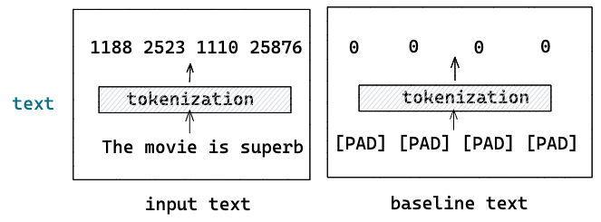
Integrated Gradients
CODING TIME!!
Slide credit: https://towardsdatascience.com/interpreting-the-prediction-of-bert-model-for-text-classification-5ab09f8ef074

Slide 33
Integrated Gradients
The Integrated Gradients method is a way to make a classification model interpretable.
It can be used for all models that are differentiable, i.e. derivable. This includes, for example, neural networks, but not the basic machine learning models, such as Random Forest or Linear Regression.
Applications of the Integrated Gradient method include, for example, finding out the feature importance, debugging models, as well as improving the data set with respect to the important features.
A baseline is defined that has no effect on the classification result. Then, in a few steps, interpolations are given to the model, and the gradient is used to determine what influence the individual inputs have on the result.
Slide credit:

Slide 34
Using Explanations in Practice
Appropriate use of explanations:
Mid data-science workflow
Error analysis for surprising false-positives or false-negatives
Challenges in showing explanations to end users:
Nuance in interpreting explanations
Setting appropriate expectations
Training and clear user experience required
Caution in using explanations in automated capacity:
Avoid automated workflows based solely on explanations
Use explanations to flag items for manual review
Compute requirements for obtaining explanations:
Fitting a few thousand small models per explanation
Takes 20-30 seconds on a 2020 laptop
Not prohibitive for single data points
Prohibitive in production environments with large datasets
Compromise for compute requirements:
End users can request explanations for specific decisions
Case-by-case basis for explanations
User experience can manage a 30-second wait
Slide credit: https://brainsteam.co.uk/2022/03/14/painless-explainability-for-text-models-with-eli5/#using-explanations-in-practice

Slide 35
Five sources of bias in NLP
The Data:
Example: Gender Bias in Language Models
Language models trained on biased text data may exhibit gender bias in their output, reinforcing stereotypes or reflecting societal biases present in the training data.
The Annotation Process:
Example: Racial Bias in Sentiment Analysis
Biased annotations by human annotators can introduce racial bias in sentiment analysis systems, leading to skewed interpretations of text sentiment based on the racial or ethnic identity of the author.
The Input Representations:
Example: Bias in Named Entity Recognition (NER)
Biased representations in NER can lead to underrepresentation or misclassification of certain names or entities, such as ethnic or culturally diverse names, due to limitations in the training data or biased algorithms.
The Models:
Example: Socioeconomic Bias in Automated Resume Screening
Models trained to screen resumes for job applications may exhibit bias against candidates from lower socioeconomic backgrounds, as certain features or patterns associated with disadvantaged groups may be inadvertently penalized or overlooked.
The Research Design:
Example: Confirmation Bias in Sentiment Analysis Studies
Research studies on sentiment analysis that focus only on specific domains or user demographics may introduce confirmation bias, providing a limited perspective and failing to capture the full range of opinions and sentiments expressed across diverse populations.
Notes:
1- Selection bias (minority groups
2- In its simplest form, bias arises because annotators are distracted, uninterested, or lazy about the annotation task. As a result, they choose the ‘wrong’ labels – birden fazla kişinin aynı şeyi etiketlemesi..
3-), gender biases in the training data
https://www.mzes.uni-mannheim.de/socialsciencedatalab/article/bert-explainable-ai/
Language models trained on biased text data may exhibit gender bias in their output, reinforcing stereotypes or reflecting societal biases present in the training data. İnsan etiketleyiciler tarafından yapılan önyargılı etiketlemeler,
duygu analizi sistemlerinde ırksal önyargıya neden olabilir. Bu durum, metin duygusunun yorumunda yazarın ırksal veya etnik kimliğine dayalı olarak eğik yorumlamalara yol açabilir.
Örnek: İsim Varlık Tanıma (NER) Önyargısıİsim varlık tanıma sistemlerindeki önyargılı temsiller, eğitim verilerindeki sınırlamalar veya önyargılı algoritmalar nedeniyle etnik veya kültürel açıdan çeşitli isimlerin veya varlıkların eksik veya yanlış sınıflandırılmasına yol açabilir.
Örnek: Otomatik Özgeçmiş Değerlendirmede Sosyoekonomik Önyargıİş başvurularını değerlendirmek için eğitilen modeller, düşük sosyoekonomik geçmişi olan adaylara karşı önyargı sergileyebilir. Dezavantajlı gruplarla ilişkilendirilen bazı özellikler veya desenler yanlışlıkla cezalandırılabilir veya gözden kaçırılabilir.
Yalnızca belirli alanlara veya kullanıcı demografiklerine odaklanan duygu analizi üzerine yapılan araştırma çalışmaları, onaylama önyargısını dahil edebilir. Bu durum, sınırlı bir perspektif sunar ve çeşitli toplumlar arasında ifade edilen farklı görüş ve duyguların tam yelpazesini yakalamada başarısız olabilir.

Slide 36
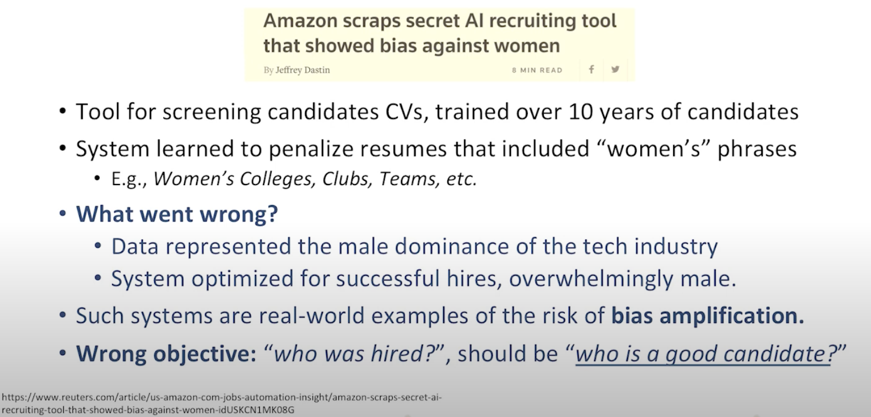
Social Bias
Thank You!
Slide credit:

Slide 37
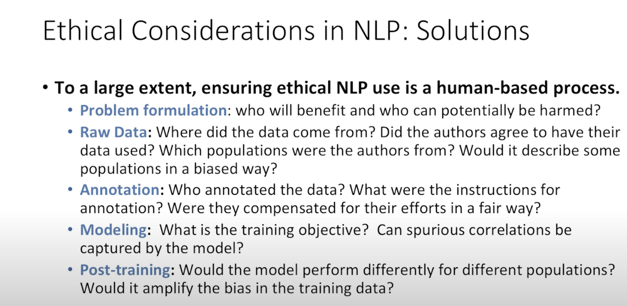
Ethical Considerations in NLP : Solutions
Thank You!
Slide credit:

Slide 38
The End
Thank You!
Slide credit:

